Slide 1
How to be an award winning homecare provider

Slide 2
Home Instead Senior Care in the UK
175 franchised offices across the UK
Serve c.10,000 clients
£100,000,000 annualised turnover
7 CQC Outstanding ratings in England
11 years old today!

Slide 3
Our Mission
To become
the UK’s most admired
care company
through changing the face of ageing
Notes:
Network for both at the same time
GP’s surgeries – do you know anyone looking for work
Assisted living – people mobile, may want work
Schools – dinner ladies
Listen to what people are saying

Slide 4
Our Mission
To become
the UK’s most admired
care company
through changing the face of ageing
and the UK’s employer of choice
Notes:
Network for both at the same time
GP’s surgeries – do you know anyone looking for work
Assisted living – people mobile, may want work
Schools – dinner ladies
Listen to what people are saying

Slide 5
Great News
What we do is not rocket science
We have no unique intellectual property
We don’t have any killer processes that can’t be replicated
Every other provider across the UK can do the same

Slide 6
The best way to win awards is not to focus on them!

Slide 7
So how have we achieved this?
Focusing on our People
Recruiting for cultural fit, training for skills
Never, ever, compromising on our values
Train, train and then train again!
Charging a fair rate that enables us to look after our people
The most important word in our vocabulary is Always
Consistently measuring what you are doing

Slide 8
Focusing on our People
If you look after your people, they will look after your clients
Day to day I’m the least important person in the business
Its about common sense not blind compliance
Do not create a be happy go broke culture!
Make sure your model works for your people

Slide 9
Recruit for cultural fit, train for skills
Most businesses are not rocket science
Recruit bright, positive people who are keen to learn
Never recruit someone who is a poor cultural fit for their job skills
ICEBERG
SKILL
ATTITUDE

Slide 10
Never, ever, compromise on your values
Strong performance in a position does not trump culture
Act quickly when cultural fit is an issue

Slide 11
Train, train and then train again!
In as many ways as possible
As frequently as is necessary
Develop team skills and camaraderie as well as technical skills

Slide 12
Charge a fair rate that enables you to look after your people
Employers of choice do not pay minimum wage
If you cant pay a fair salary on the rate
you receive don’t take on the work
UKHCA minimum price for care
is £16.70 per hour
And that’s based on minimum wage
and minimum training

Slide 13
The most important word is Always
Always focus on your culture
Always put your people first
Always train your people
Always focus on retaining and developing you best people
Always deliver outstanding care
Always measure what happening

Slide 14
Consistently measuring what you are doing
We measure client satisfaction and employee engagement:
This drives a culture of continuous improvement
Develops initiatives that engage CAREGivers to deliver quality care to our clients
Shapes our business plans
It works!
Client advocacy has improved in 2015 to 65%
For context Mercedes Benz 37%
Notes:
– gives us an understanding of areas we need to improve

Slide 15
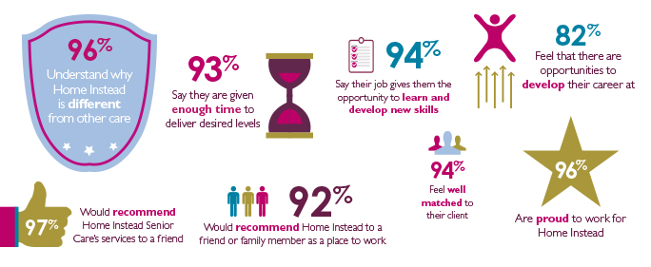
PEAQ CAREGiver Results 2015
Notes:
96% are proud to work for Home Instead

Slide 16
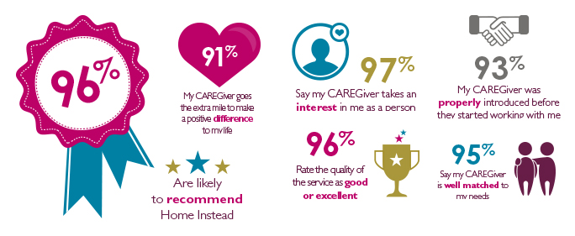
PEAQ Client Results 2015

Slide 17
How to be an award winning homecare provider

Slide 18
Conclusion
What we do is not rocket science
We have no unique intellectual property
You need
Passion
Strong vision and values
Great people
A genuine desire to put your people first and
The resolve to stick to your model
It is hard work, but it is not difficult!

Slide 19
trevor.brocklebank@homeinstead.co.uk

